Slide 1
Olist Customer Analytics Dashboard
Interactive dashboard project — Power BI / Tableau concept
Dataset: Olist customer dataset
Objective: understand customer coverage and geographic concentration
Prepared for business stakeholder reporting

Slide 2
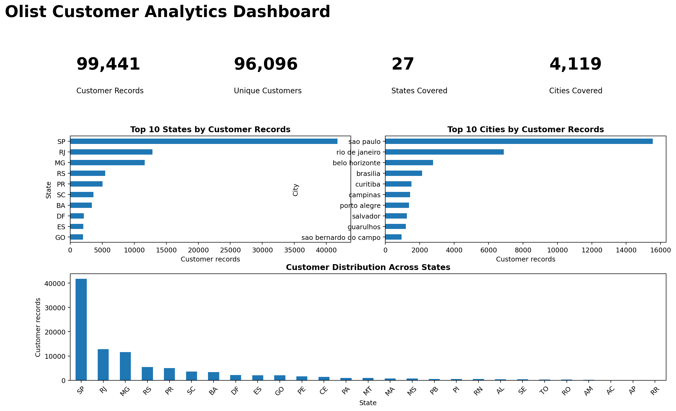
Dashboard Overview
Customer KPIs and geographic distribution

Slide 3
Key Business Insights
The dataset contains 99,441 customer records representing 96,096 unique customers.
Customers are distributed across 27 Brazilian states and 4,119 cities.
SP is the largest customer state in the uploaded dataset with 41,746 records.
Sao Paulo is the largest customer city with 15,540 records.
Geographic concentration can help prioritize regional marketing, logistics capacity, and customer-service resources.

Slide 4
Business Recommendations
Prioritize high-customer-volume states and cities for targeted campaigns.
Use geographic segmentation to compare customer acquisition and retention once order/financial data is joined.
Add order, payment, product and review datasets to enable Sales, Profit, Growth and Customer Lifetime Value KPIs.
In Power BI, add State and City slicers and drill-through pages for regional analysis.

